Slide 1

Institute of Data
Mini Project #1
Samantha Carlson
February 2021

Slide 2
Background
I work for a publishing house and they are looking to publish some new material.
They have asked me to research the best type of book they should publish next to see the best financial return.

Slide 3
Pipeline
Data acquisition
01
Clean & Explore
02
Visualisation
03
Data analysis
04
Decision making
05

Slide 4
The data
1.
Amazon's best-selling books from 2009 to 2019
550 rows × 7 columns
Name
Author
User Rating
Reviews
Price
Year
Genre
Kaggle dataset: https://www.kaggle.com/sootersaalu/amazon-top-50-bestselling-books-2009-2019

Slide 5
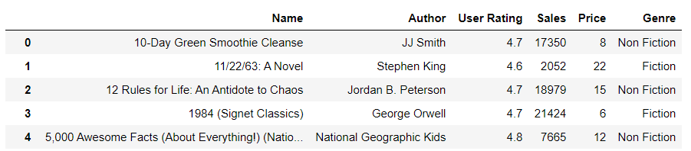
Clean & Explore
2.
True zero values
Number of sales (from reviews)
Deletion of ‘Year’ column

Slide 6
Visualisation
3.
4.
Analysis

Slide 7
The Business Question
Background:
I work for a publishing house and they are looking to publish some new material. They have asked me to research the best type of book they should publish next to see the best financial return.
Breaking it down:
1. Which genre of book would be the most profitable to publish?
2. Does the price of the book impact the number of sales (can we predict a price 'sweet spot' to make the most profit)?
3. Does the price of a book impact the user ratings (i.e. does an expensive book have lower or higher ratings than a lower priced book

Slide 8
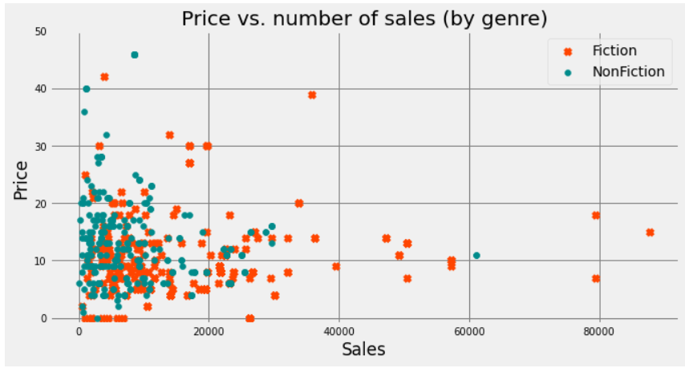
Fiction vs. Non-Fiction - Scatter

Slide 9
Fiction vs. Non-Fiction - Figures
 | Fiction | Non-Fiction
Price (mean) | $ 10.85 | $ 14.84
Sales (mean over 10 years) | $ 15,683.80 | $ 9,065.15
Profit (of means over 10 years) | $ 170,170 | $ 134,544
From these figures we can see that over 10 years, a Fiction book will be more profitable than a Non-Fiction book – even though Fiction books have a lower average sale price.

Slide 10
The Business Question
What is the best type of book to publish for the best financial return?
Breaking it down:
1. Which genre of book would be the most profitable to publish? → Fiction
2. Does the price of the book impact the number of sales (can we predict a price 'sweet spot' to make the most profit)?
3. Does the price of a book impact the user ratings (i.e. does an expensive book have lower or higher ratings than a lower priced book)?

Slide 11
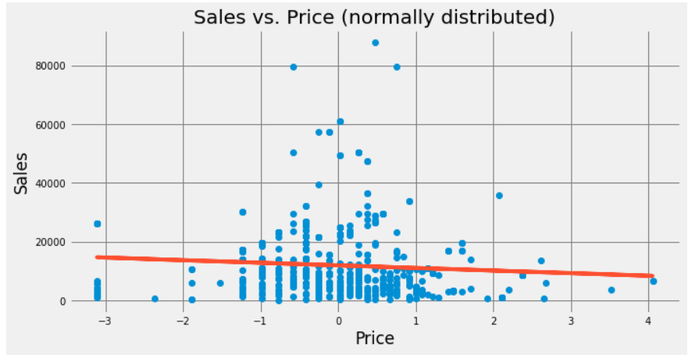
Price vs. Sales
Lower = $2.28
Mean = $10.85
Upper = $19.42

Slide 12
The Business Question
What is the best type of book to publish for the best financial return?
Breaking it down:
1. Which genre of book would be the most profitable to publish? → Fiction
2. Does the price of the book impact the number of sales (can we predict a price 'sweet spot' to make the most profit)? → Between $2 and $19
3. Does the price of a book impact the user ratings (i.e. does an expensive book have lower or higher ratings than a lower priced book)?

Slide 13
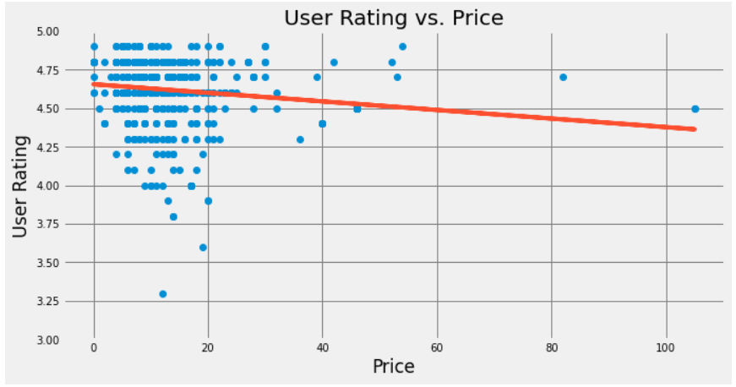
User rating vs. Price
The lower the price, the higher the user rating

Slide 14
The Business Question
What is the best type of book to publish for the best financial return?
Breaking it down:
1. Which genre of book would be the most profitable to publish? → Fiction
2. Does the price of the book impact the number of sales (can we predict a price 'sweet spot' to make the most profit)? → Between $2 and $19
3. Does the price of a book impact the user ratings (i.e. does an expensive book have lower or higher ratings than a lower priced book)? → the lower the price, the higher the rating

Slide 15
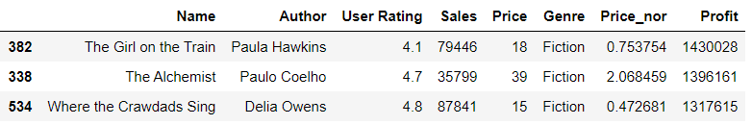
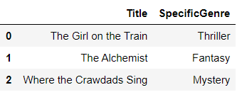
Additional considerations
Which specific genre would produce the highest profit?

Slide 16
Recommendation
The best book to publish to make the most profit is:
Fiction;
specifically, thriller, horror, or fantasy
Priced between $2 and $19

Slide 17
Limitations
A publishing company cannot guarantee or predict the user ratings a book will receive.
This data set only considers those books with a user rating of 3.3 to 4.9. The number of sales of lower rated books could change the data significantly.
The sample size of this data set is quite small (550 observations with a number of duplicates where editions/versions of books were published in various years) which may provide a skewed view of the actual 'real-world' sales and ratings figures.

Slide 18
Questions?

